Slide 1
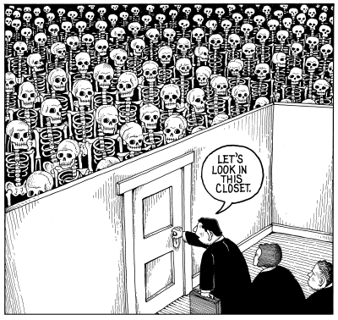
Lecture 19
Chemical Engineering for Micro/Nano Fabrication

Slide 2
Exam II
When: 9:30- 11 AM Thursday Nov. 15th
Where: FNT 1.206A
What: Lectures through 11/14/2018
Bring: Pencil and eraser
Do: Study notes, review quizes and ask questions…work with a friend??

Slide 3
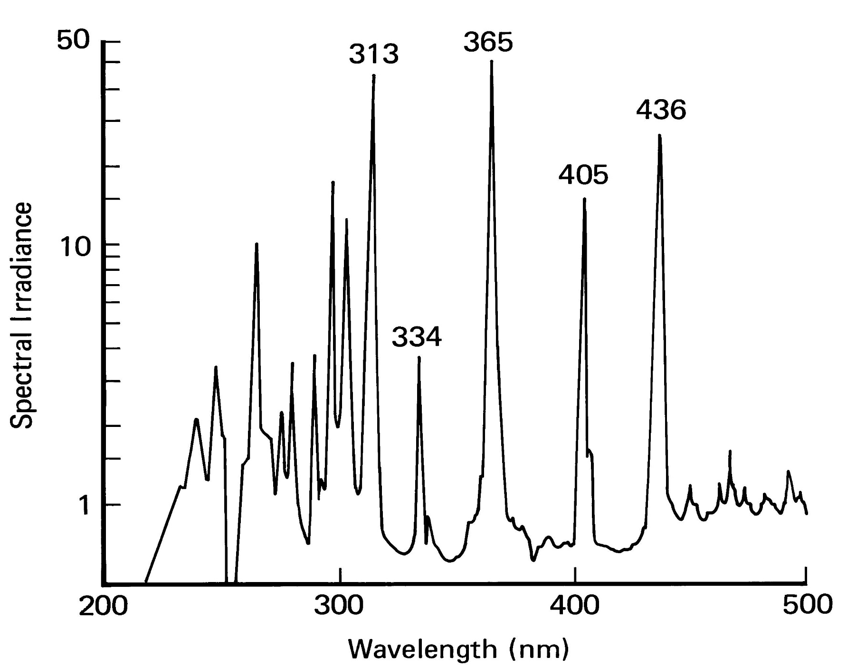
Mercury Xenon Lamp Output

Slide 4
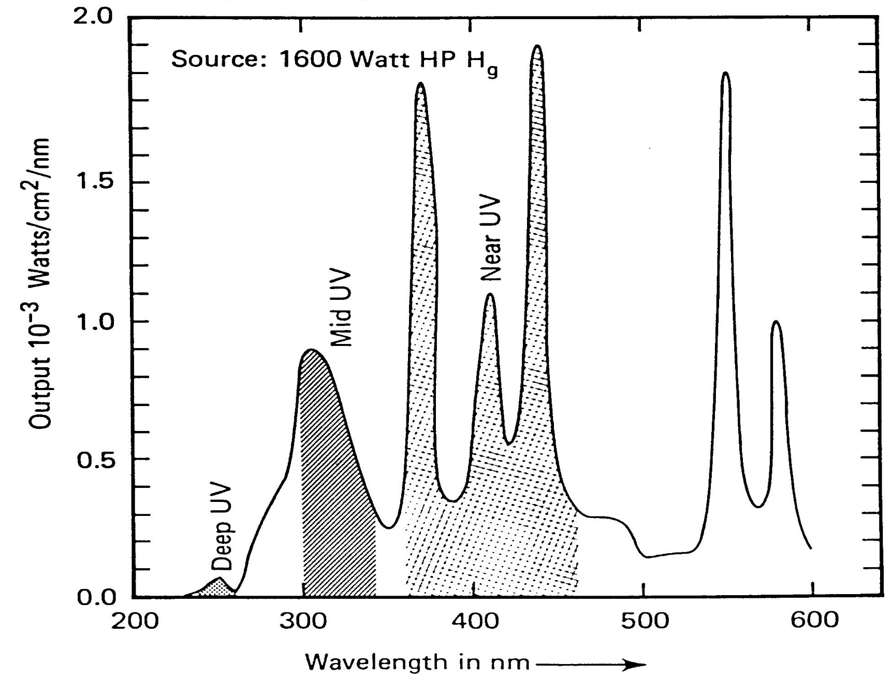
Incident Power at the Wafer Plane PE-500

Slide 5
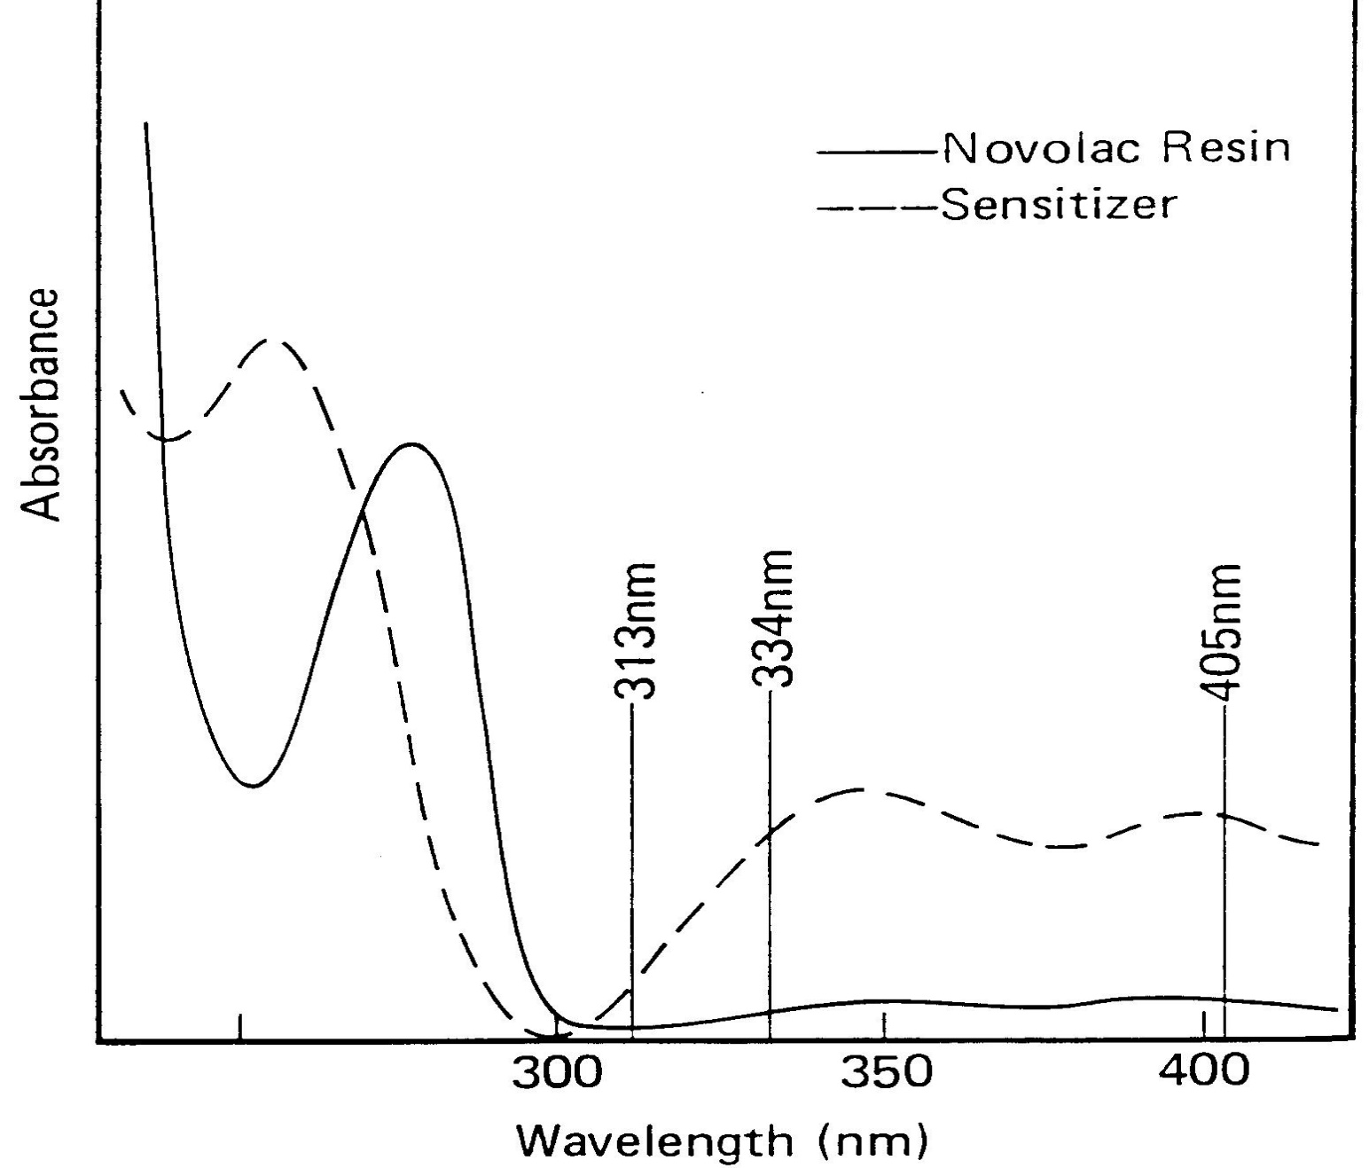
UV Spectra of Novolac and Diazonaphthoquinone

Slide 6
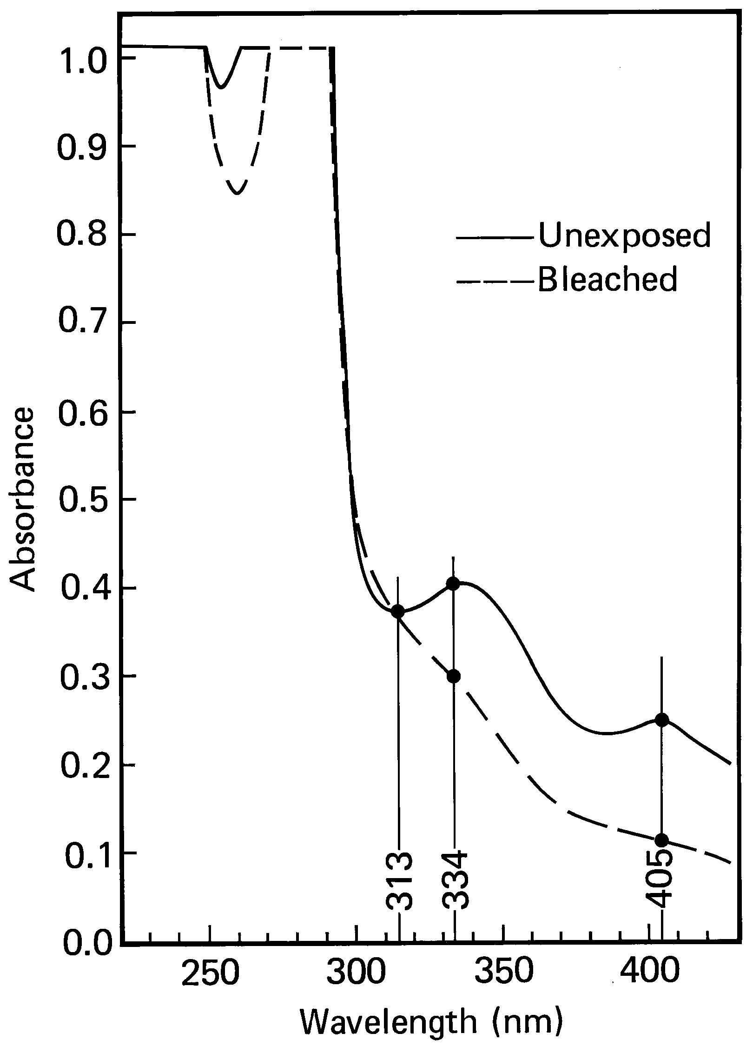
bad!

Slide 7
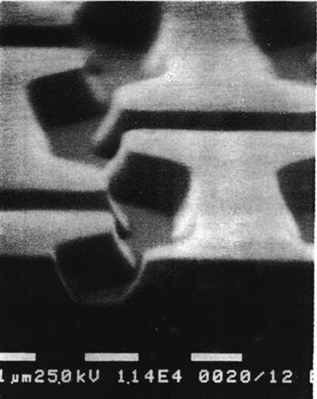
Sloped Sidewalls In Novolac-Based DUV Resists
High unbleachable absorption leads to
heavily sloped sidewalls
in novolac-based resists
imaged at 248 nm.

Slide 8
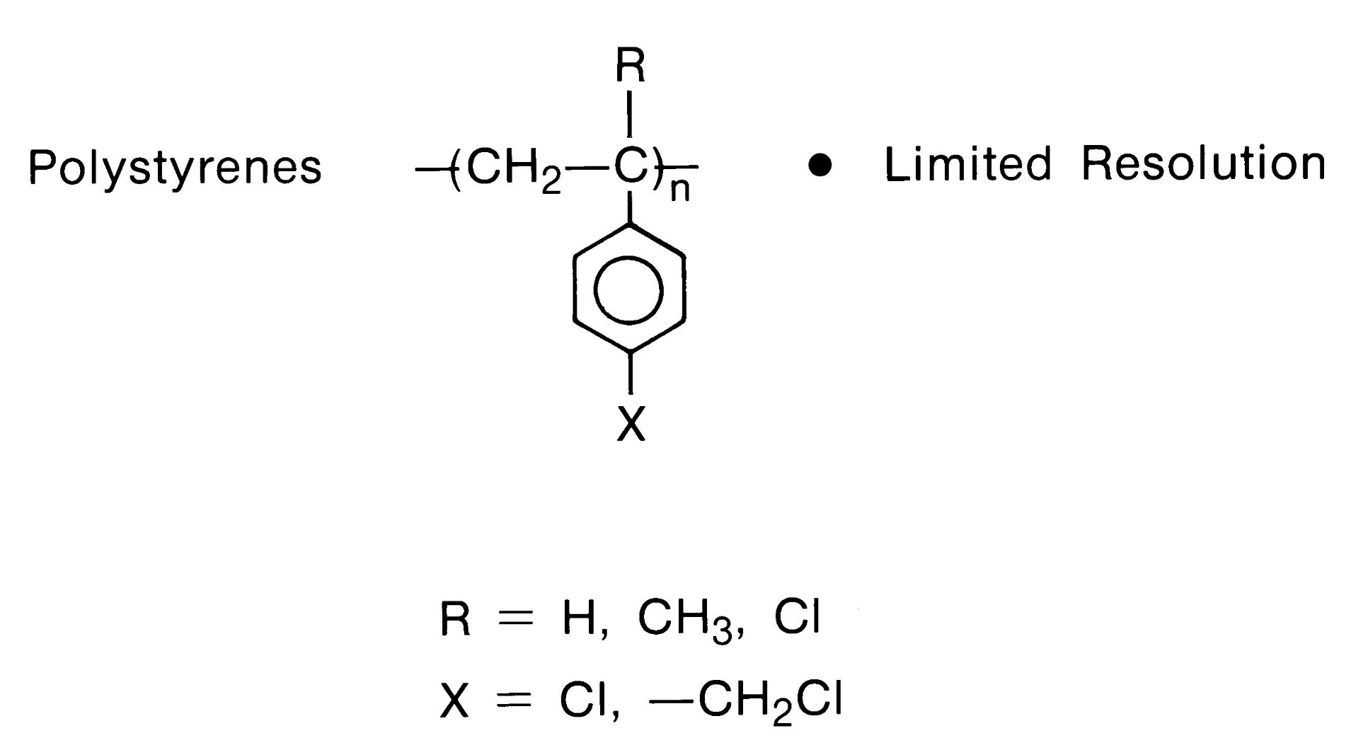
Single Component Negative Tone

Slide 9
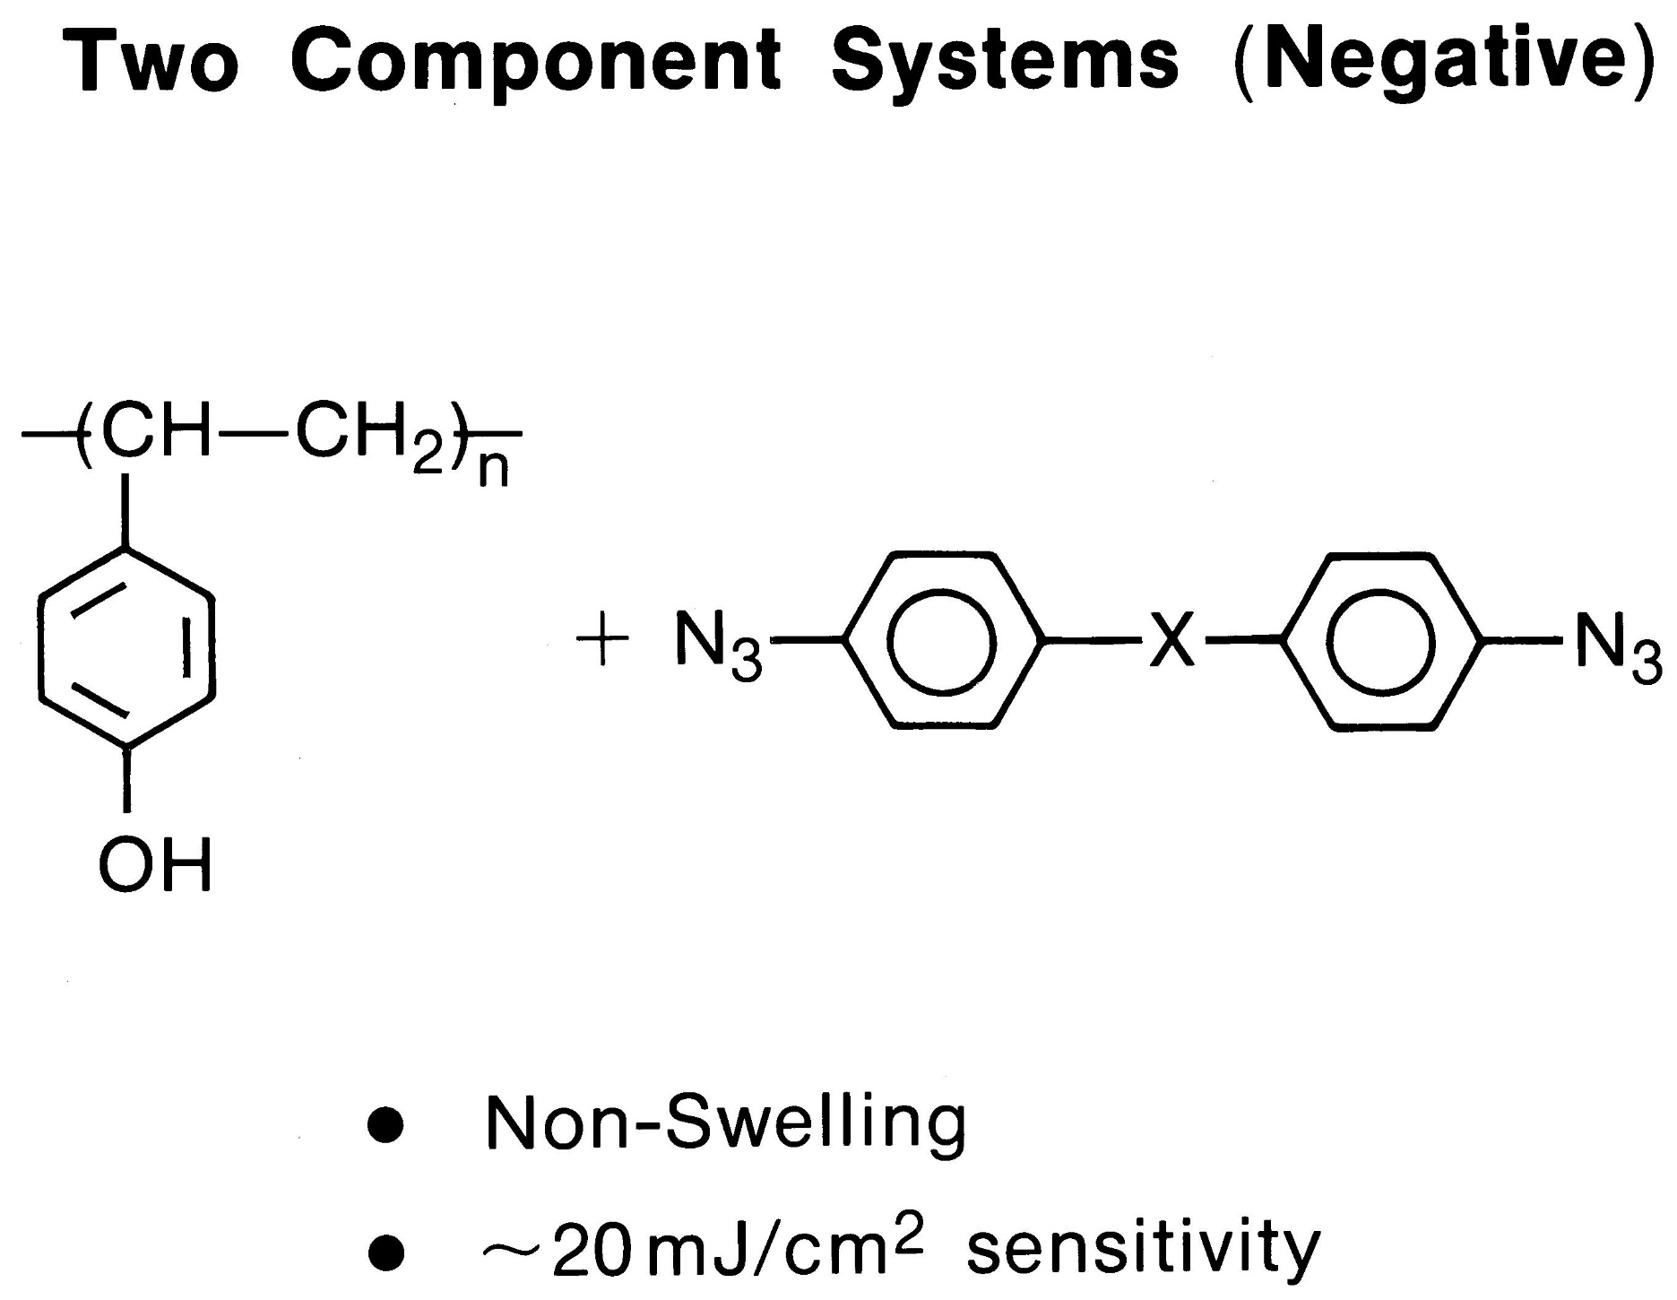
Two Component Systems - Negative tone
Hitachi

Slide 10
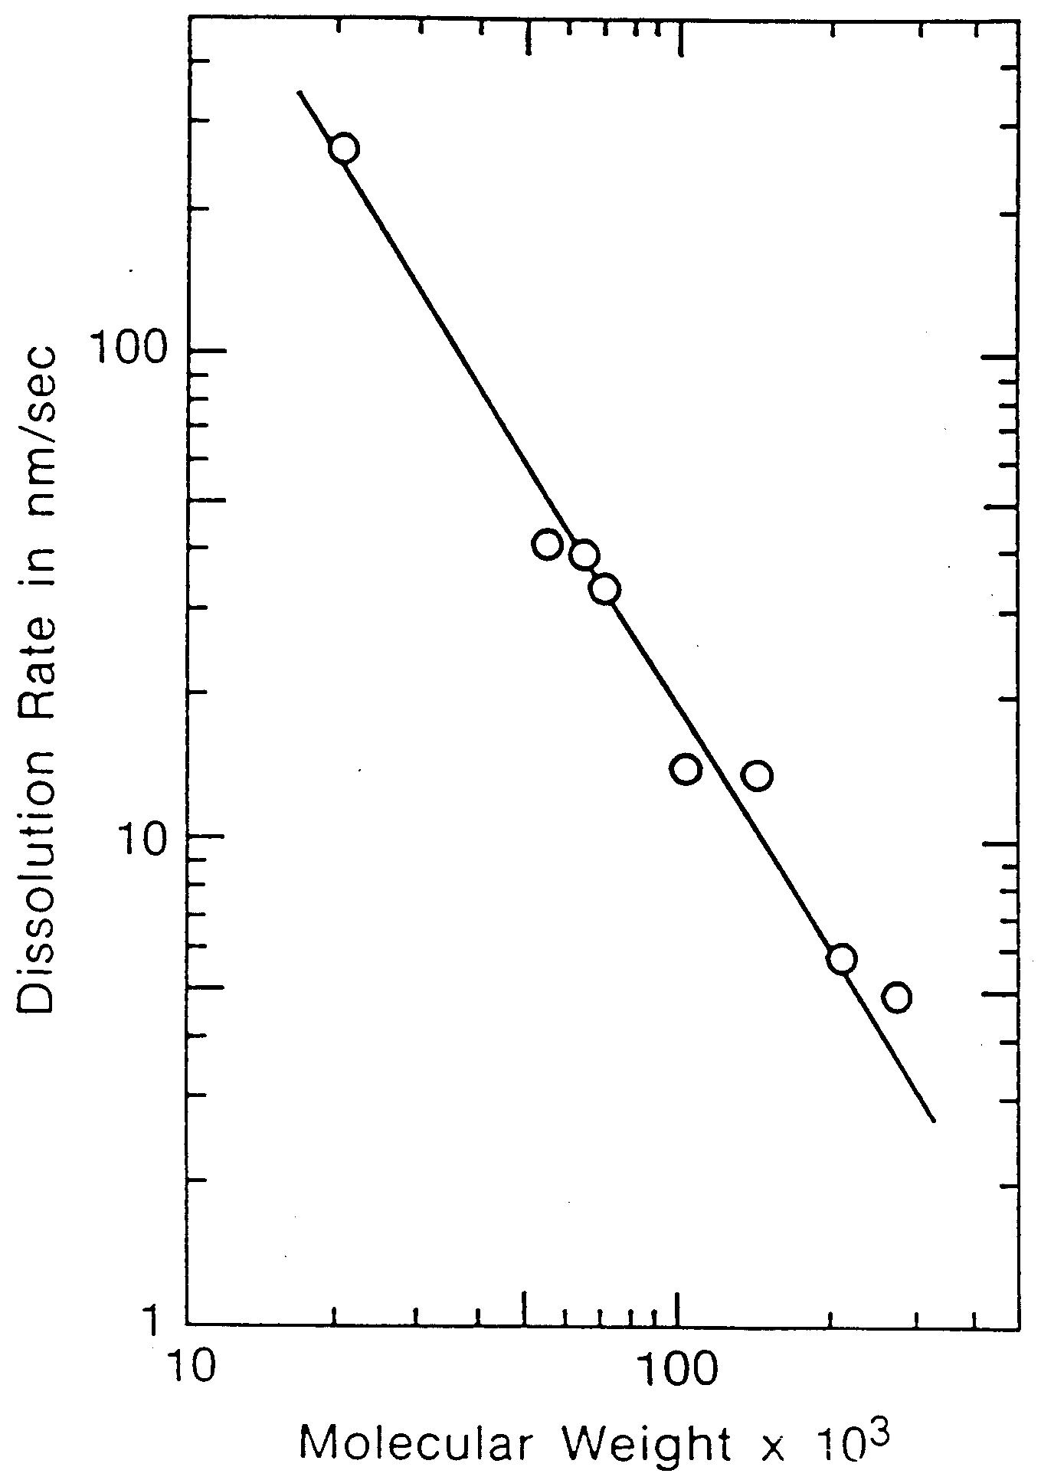
Poly(p-hydroxystyrene)
No swelling!!!
But……

Slide 11
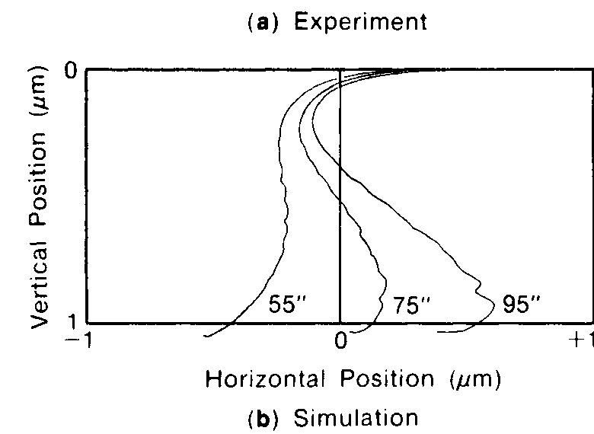

Slide 12
Is there an I-line like positive resist for DUV??? If this can be done in the DUV… it will require:
New Photoactive Compound ..not DNQ
New Resin…not Novolac
More light than an Hg lamp can provide

Slide 13
Ideal Sensitizer Characteristics
High Extinction at 254nm
High Quantum Efficiency
Photoproducts Transparent at 254nm
No Absorbance Above 300nm
Useful Change in Polarity
Thermal Stability
Solubility
Synthetic Access

Slide 14
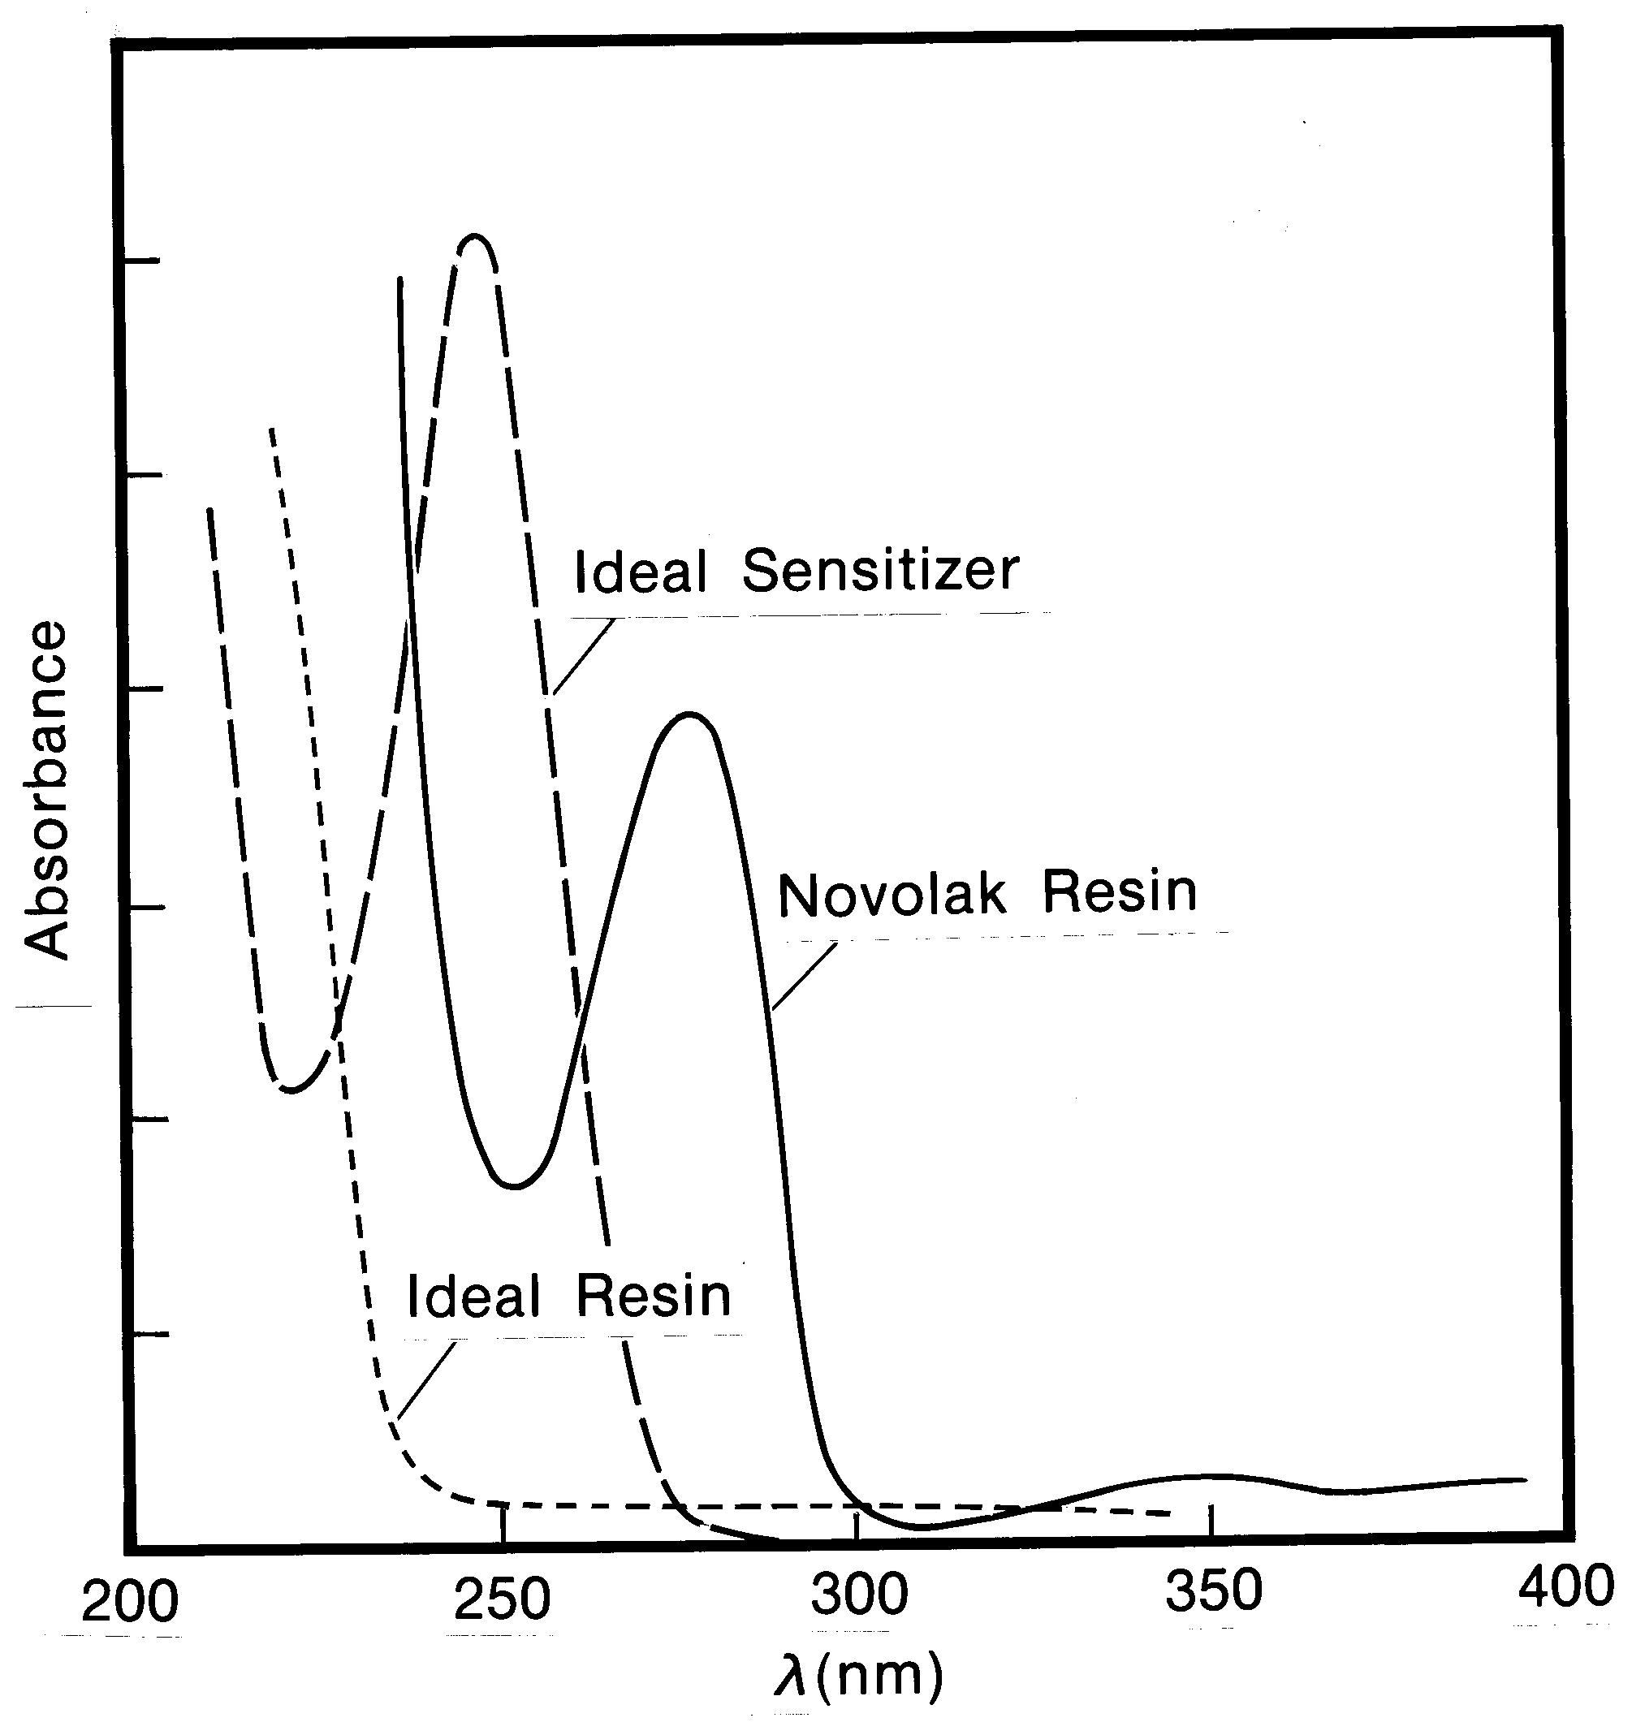
Spectral Properties

Slide 15
Candidate 1,3-Diacyl-2-diazo chromophores
Bleach in the DUV.
Good film forming properties.
Quantum efficiency of ~ 0.3
Carboxylic acid photoproducts
N-substituted 3-diazopiperidine-2,4-diones
O-substituted 3-diazo-7-hydroxy-4-oxocoumarin
Willson C. G., Miller R. D., McKean D. R., Pederson L. A., Regitz M.; SPIE Vol. 771 Advances in Resist Technology and Processing IV 1987, 2.
Willson, C. G.; Leeson, M. J.; Yeuh, W.; Steinhausler, T.; McAdams, C. L.; Levering, V.; Pawolski, A.; Aslam, M.; Vicari, R.; Sheehan, M. T.; Sounik, J. R.; Dammel, R.R.; Proc. SPIE, 1997, 22, 226
Nishimura, et. al 6923-50 SPIE 2008

Slide 16
Absorption of Photoresist Polymers
2.8
Poly-(4-hydroxystyrene)
2.4
Meta-cresol novolak
KrF
248 nm
i-line
365 nm
2.0
1.6
Absorption coefficient [1/µm]
1.2
0.8
0.4
0.0
175
200
225
250
275
300
325
350
375
400
Wavelength [nm]
Source: R.D. Allen et al., IBM J. Res. Develop. 41 (1/2), 95-104 (1997)

Slide 17
Side Chain Deprotection Design

Slide 18
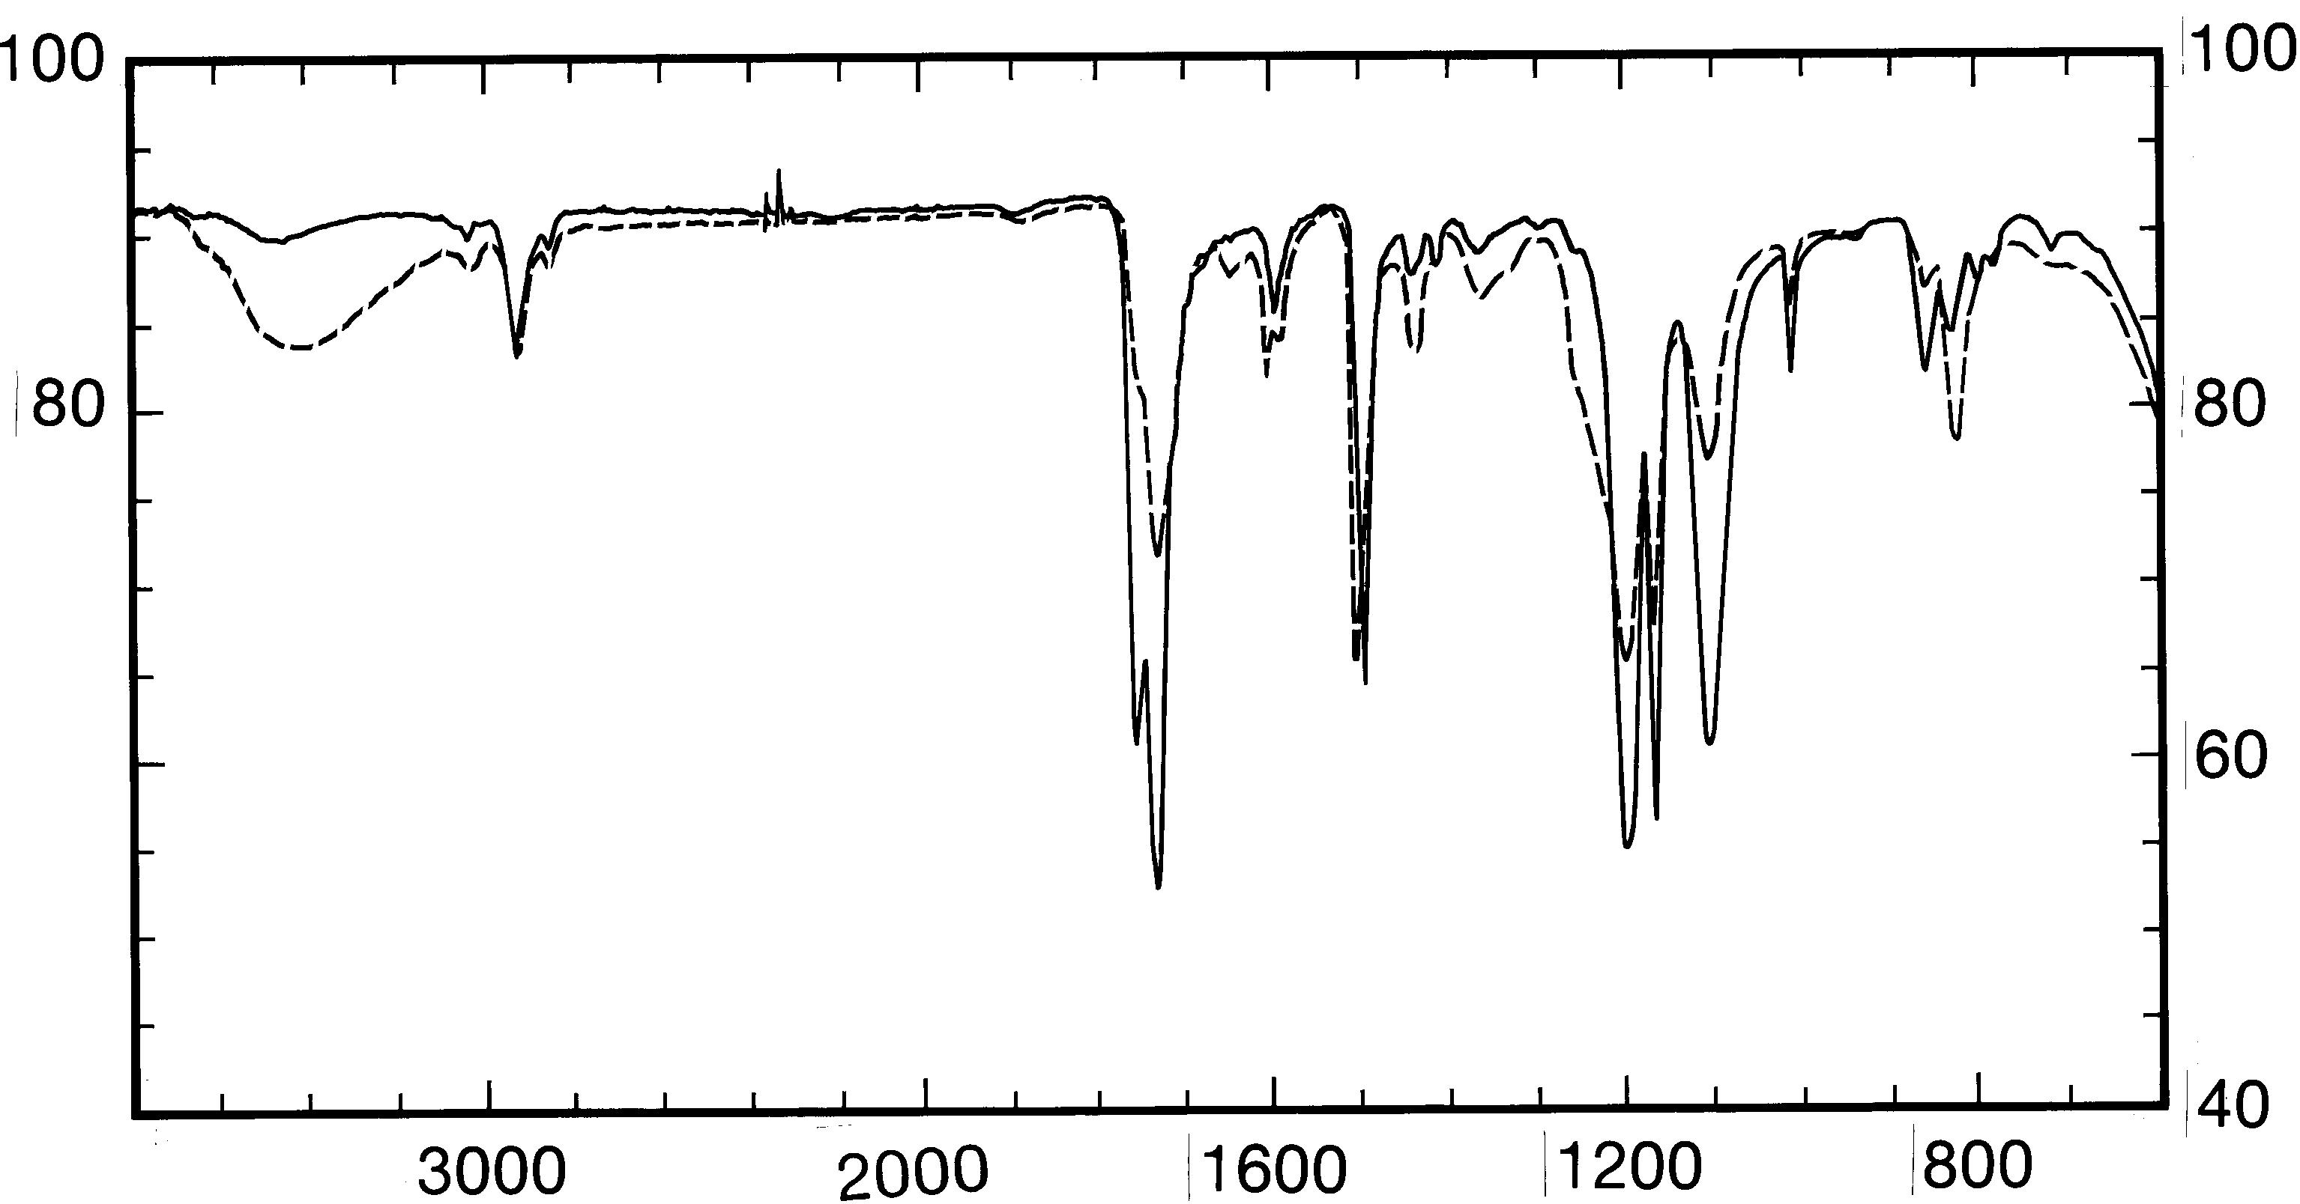
Infrared Spectrum before and after Exposure

Slide 19
Formyl Ester Deprotection Design
Can be developed in positive tone with aqueous base
Can be developed in negative tone with organic solvents
Unfortunately not storage stable due to facile hydrolysis by water.
Unfortunately too slow for Hg lamp exposure

Slide 20
These systems are wonderful but FAR TOO SLOW!!

Slide 21
Photochemistry Counts Photons
Starting Material + Photon Product
Energy/Photon, E = hv = hc/
As Wavelength Decreases, Energy/Photon Increases
Fewer photons are available for a given exposure
measured in millijoules/area
Mercury lamp produces far less Energy in the
Deep UV
Throughput Therefore Requires
-- Brighter Light Bulbs
-- More Sensitive Resists

Slide 22
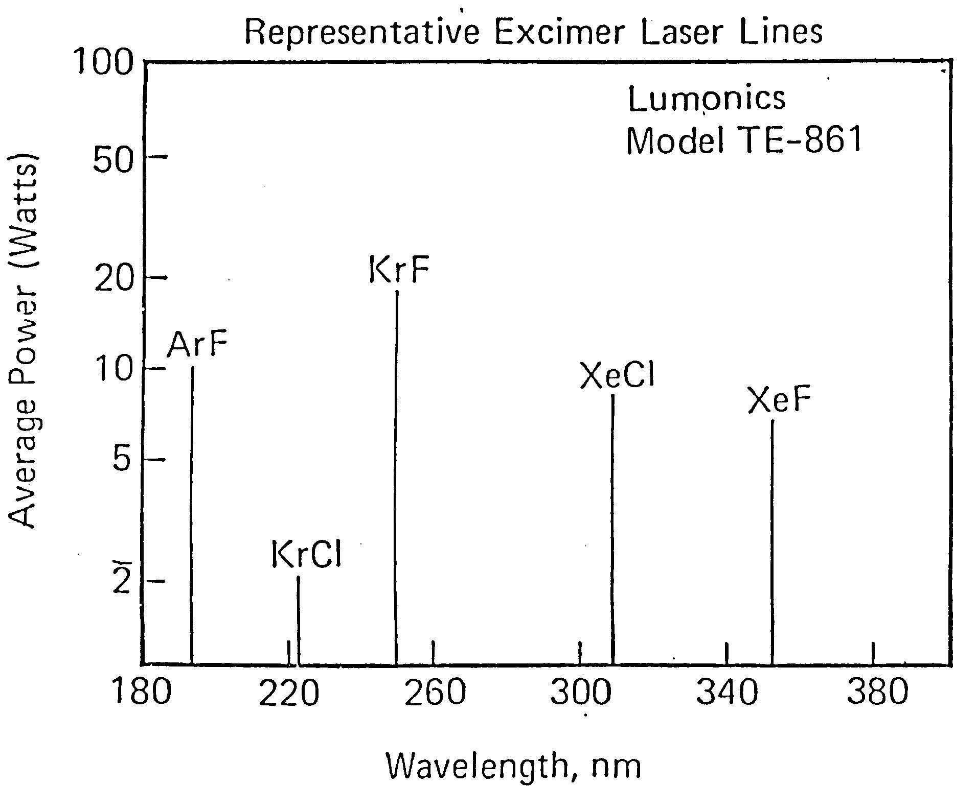
Excimer Lasers are very bright “lights”

Slide 23
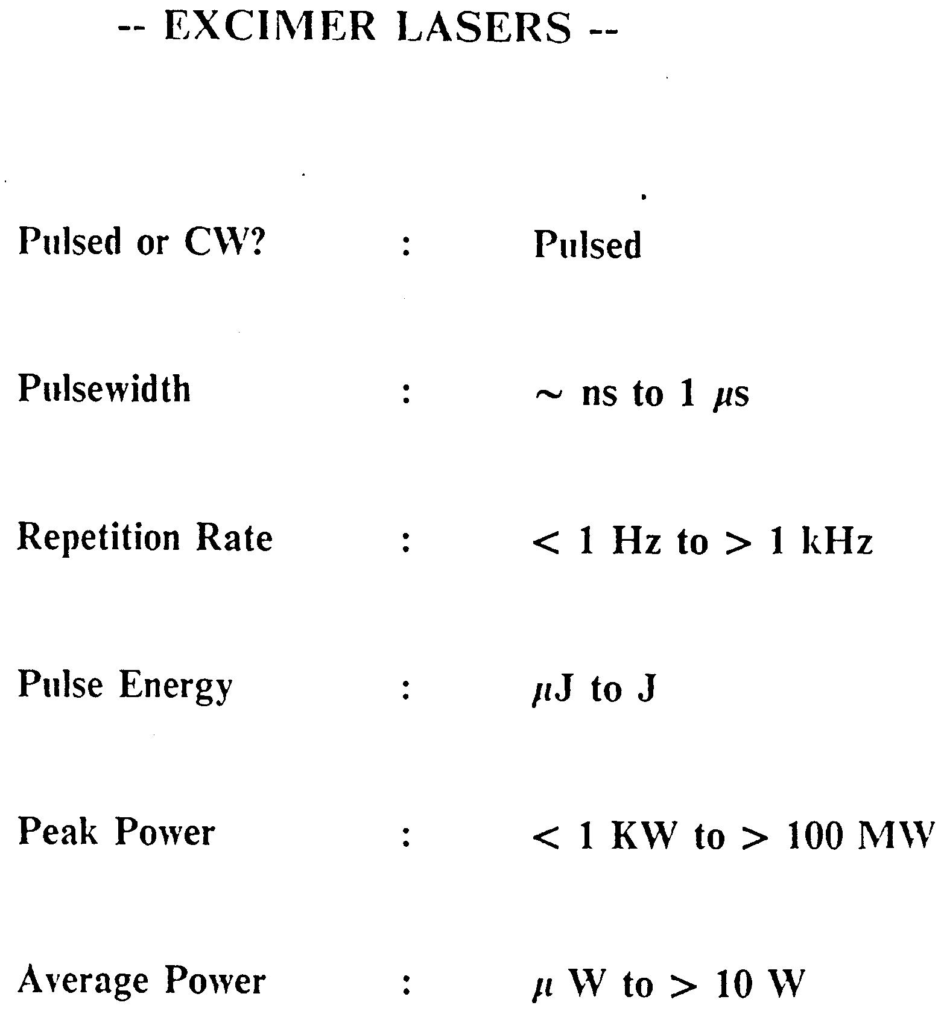
Excimer Lasers

